Slide 1
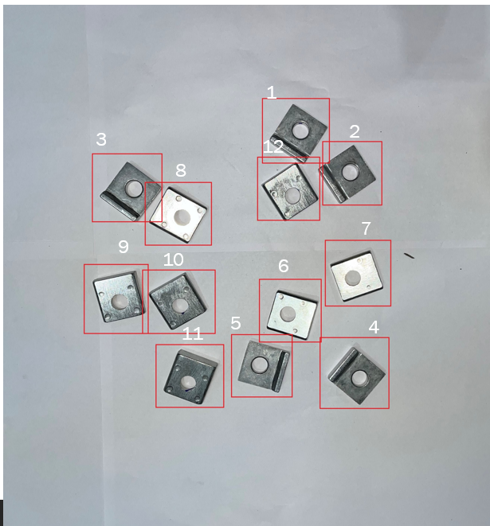

Object Counting using AI
Total number of objects - 12
Explore AI 2.0 Hackathon

Slide 2
Problem Statement
The task of counting objects manually by human-resources is a time-consuming, error prone, but a must-to-do task in some of the manufacturing processes.
We are looking for an AI driven solution to automate the process to save time and minimize errors near to zero, this will result in improved efficiency and productivity. Thus, the human resource will be free for another productive tasks.

Slide 3
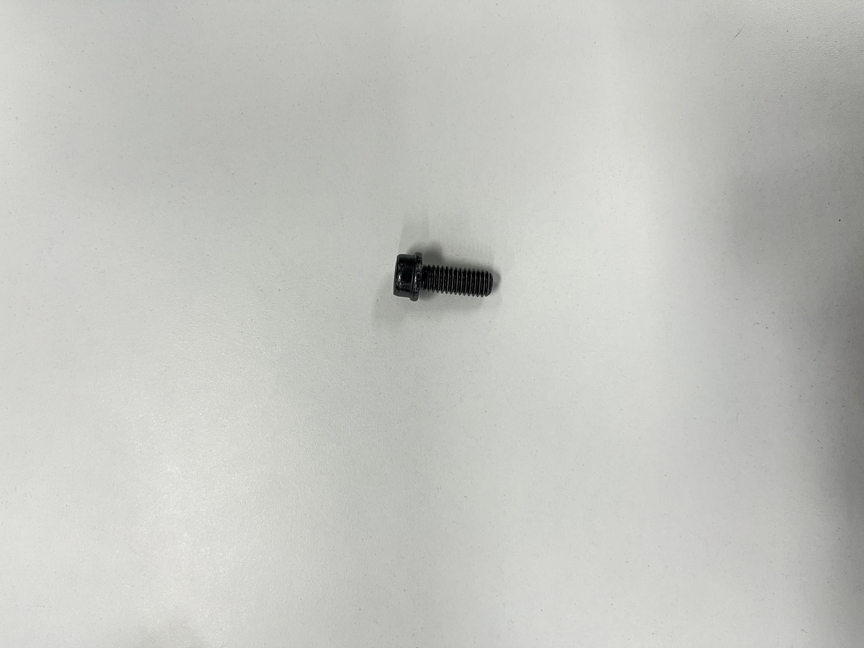

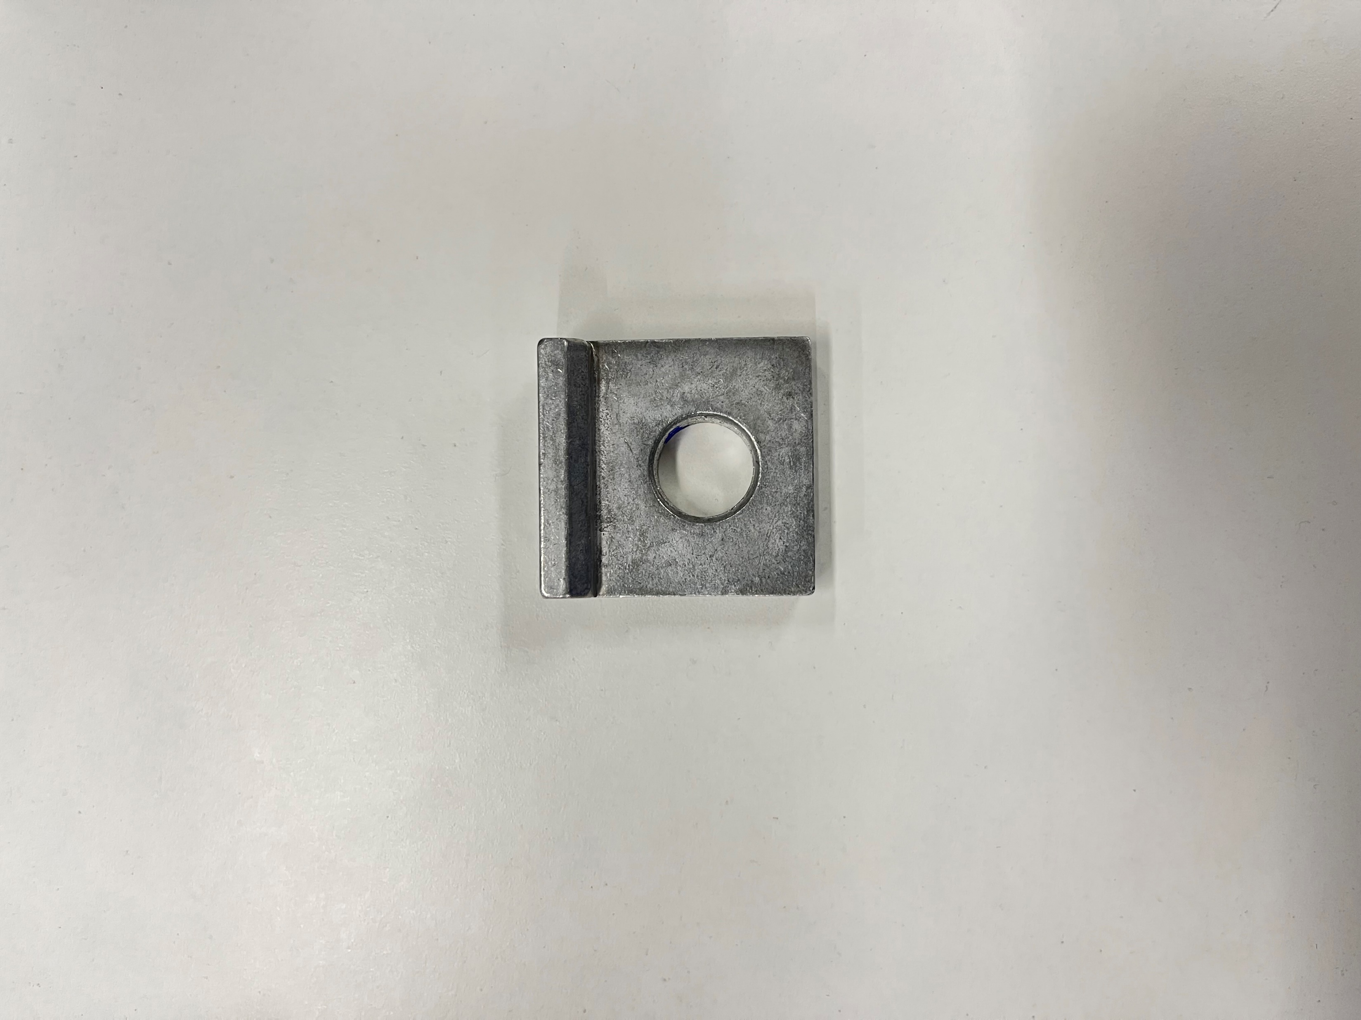
Solution Scope
The completed solution should be a generic model which is able to identify and count three types (not limited to 3 objects) of the objects given below. This model should also be built in such a way that after adding more pictures of other kinds of objects, the model should train and give prediction on different objects pictures.
Type- A
Type- B
Type- C

Slide 4
Sample Dataset
The problem statement includes a dataset of images.
Type A - 76 images
Type B - 69 images
Type C - 32 images

Slide 5

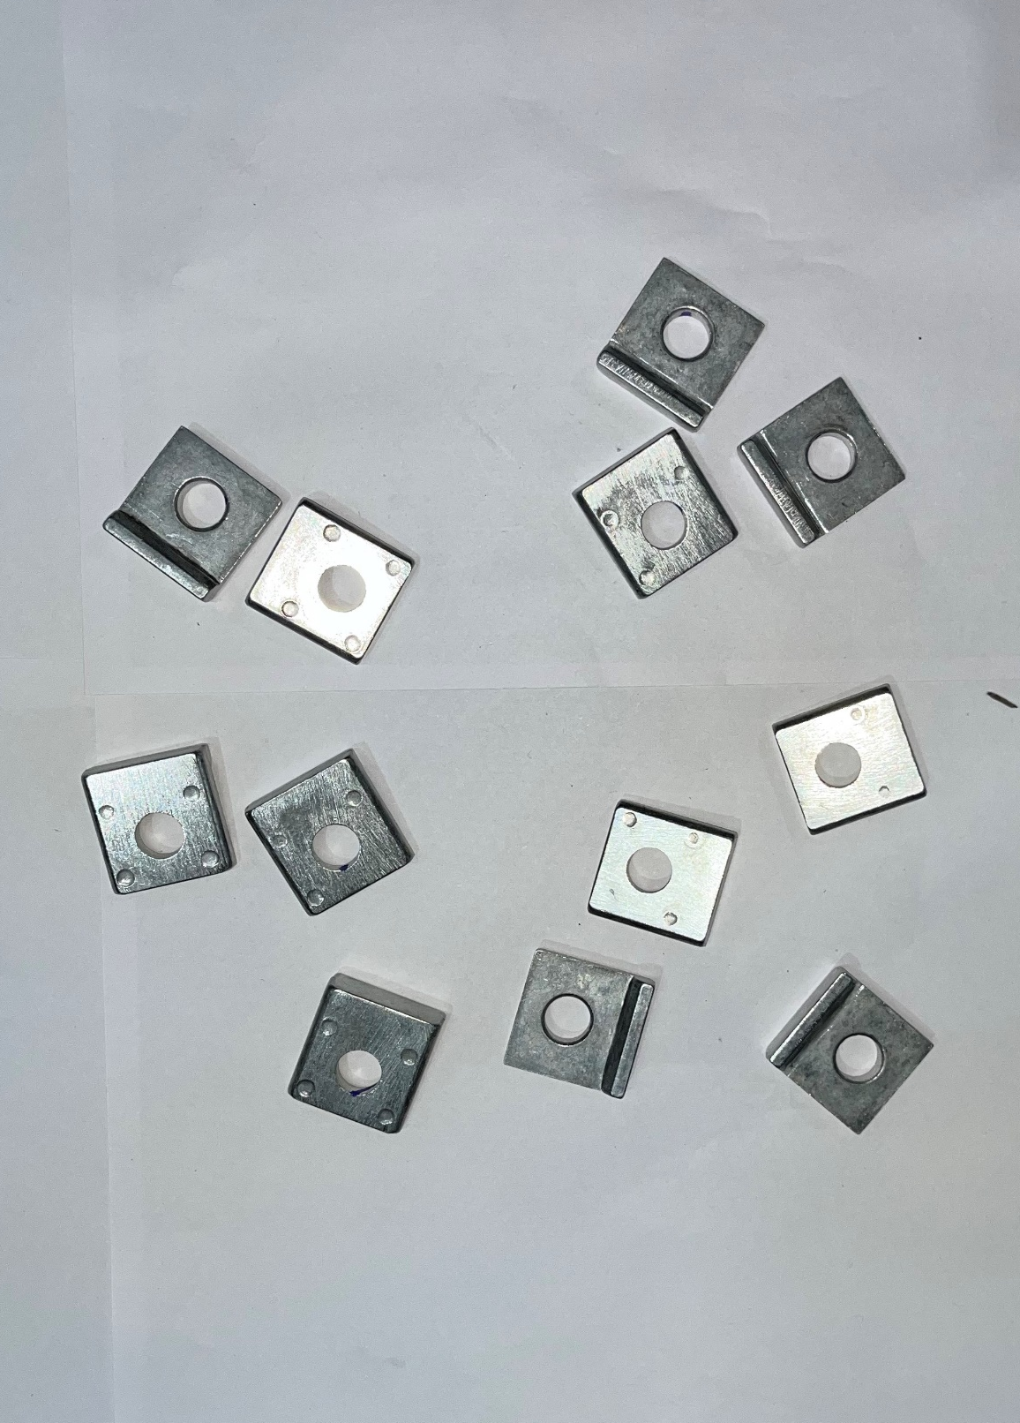

Expected Deliverable
Step-1 - Open the application and click the image in which counting of objects will be done.(Figure 1)
Step 2 – Image will be processed and we will get the output as shown in Figure 2 or 3
Step 3 – Click on Reset button to check on another image.
There can be other ways to detect and count the objects, you are free to use any method
Total objects – 12
Type- Type A
Total objects – 12
Type- Type A
Reset
Reset
There can be other ways to detect and count the objects, you are free to use any method
Figure 1
Figure 2
Figure 3

